Slide 1

INDIAN INSTITUTE OF INFORMATION TECHNOLOGY, NAGPUR
Department of Electronics and Communication Engineering
Project intern at nrsc, isro
(National Remote Sensing Center – ISRO)
First Internship Presentation on 16-09-2025
Presented by:
B. V. Sriram Vaibhav
BT22ECE056
External Mentor:
Suman Bandi
Scientist-D, NRSC, ISRO
Faculty Mentors:
Dr. Paritosh D. Peshwe Dr. Rashmi Ranjan
Duration of Internship: May 2025 – Oct 2025 (5 MONTHS)

Slide 2

ABOUT ORGANIZATION
National Remote Sensing Centre (NRSC) is a key unit of Indian Space Research Organization (ISRO).
Specializes in satellite data reception, processing, and distribution for various national applications.
Plays a crucial role in remote sensing, satellite communication, and ground station operations.
Supports diverse sectors like agriculture, forestry, water resources, disaster management, and urban planning.
Focuses on research in signal processing, communication systems, and geospatial technologies.
.

Slide 3
ABOUT MY ROLE
Internship Role: Project Student Intern ( FPGA + Digital Communication)
Worked on Digital Communication Systems for satellite applications like Phase Locked Loops (PLL), and Code Division Multiple Access (CDMA).
Designed and implemented Symbol Synchronization algorithms (Zero-Crossing & Gardner TEDs).
Developed Automatic Gain Control (AGC) with 15% faster convergence.
Applied Phase Ambiguity Resolution (PAR) using differential & unique-word methods.
Configured ADC–DAC loopback system on Zynq UltraScale+ RFSoC (ZCU208).
Set up and tested ADRV9361-Z7035 SDR board using Vivado & reference IPs.

Slide 4
Project TIMELINE
Automatic Gain Control
Symbol Synchronization
Phase Ambiguity Resolution (Differential Method)
Phase Ambiguity Resolution (Unique Word Method)
IP blocks on ADRV 9361 board
ADC-DAC loopback on ZCU208 board
Viterbi Decoding (Ongoing)
Reed-Solomon Decoding (Ongoing)

Slide 5
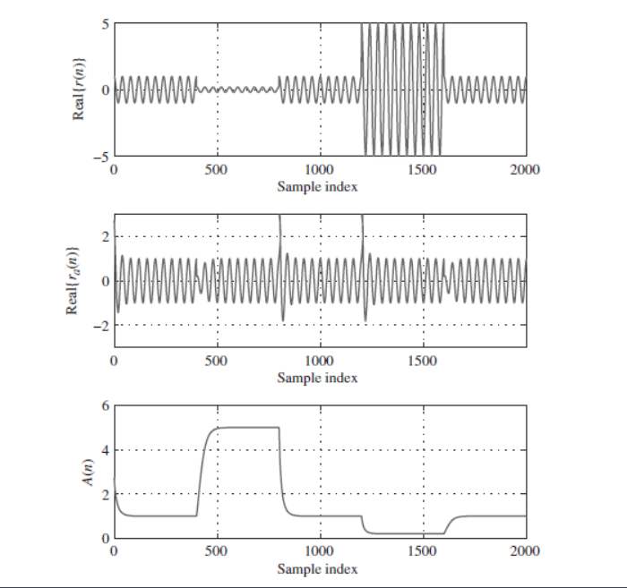
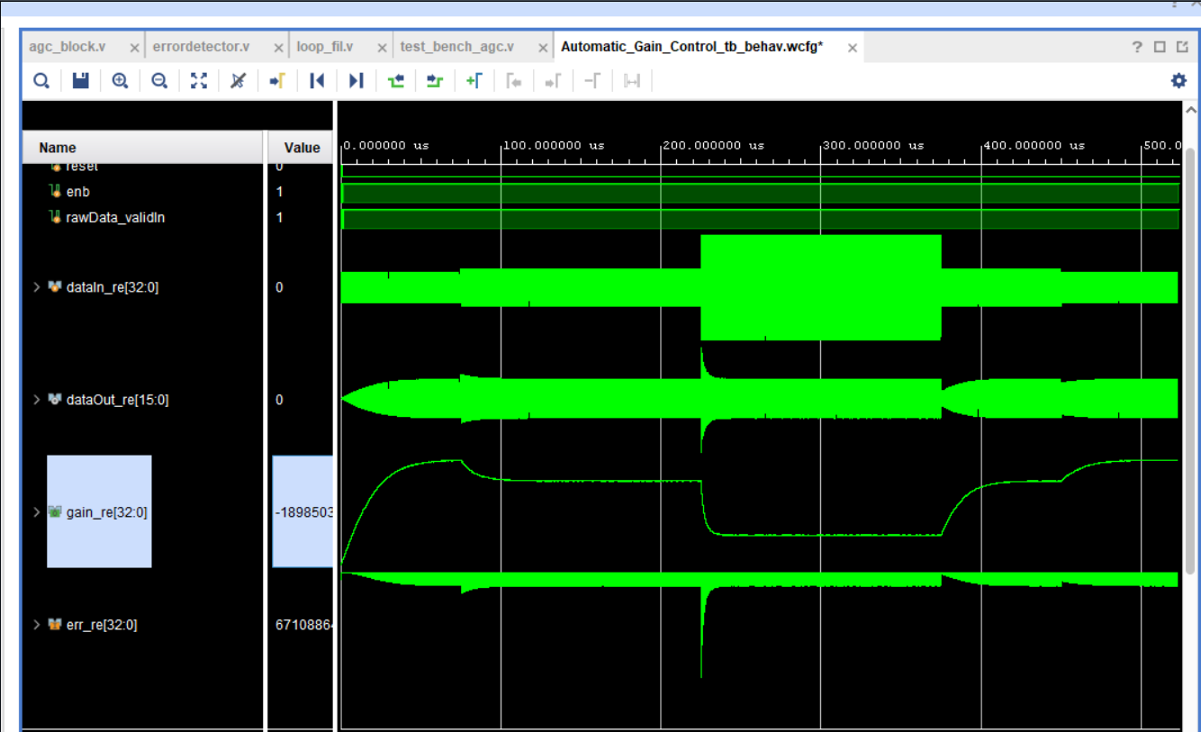
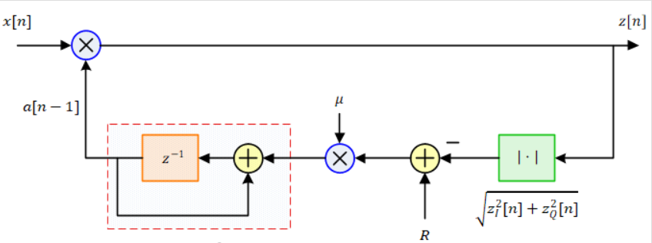
Work 1 : Automatic Gain Control
Objective:
Maintain a constant signal amplitude at the receiver despite channel variations (fading, noise) and reducing convergence time on Zynq 7000 board.
Methods Used:
Implemented conventional AGC loop using square-root detection.
Adjusts amplifier gain based on feedback to stabilize output power.
Working Principle:
Measure input signal power and compare with reference level.
Adjust gain → reduce when input is strong, increase when weak.
Outcome at NRSC:
Reduced Convergence time by ~15% compared to default results.
Ensured stable input levels for synchronization and decoding stages.

Slide 6
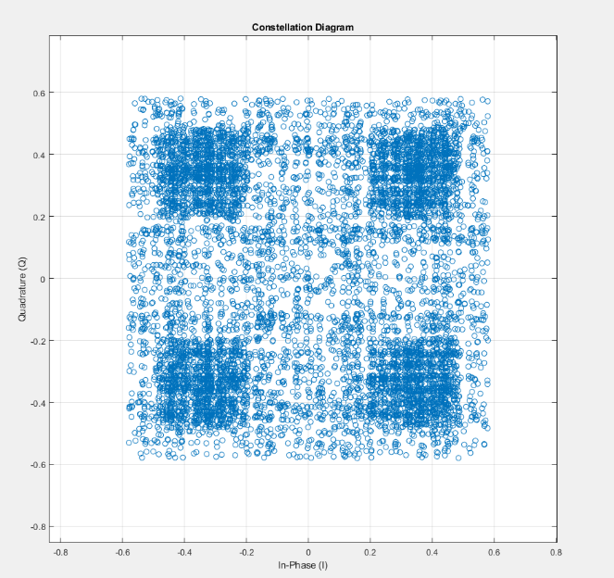
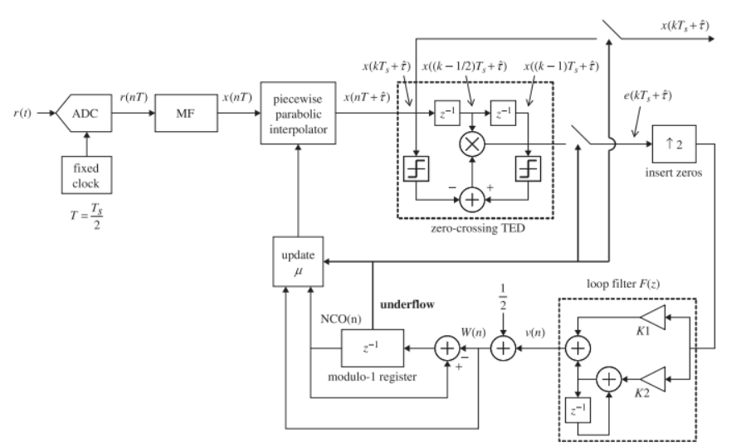
Work 2 : Symbol Synchronization
Objective:
Recover correct sampling instants so that constellation points (symbols) align clearly in the I-Q plane.
Problem Without Sync:
Timing errors cause symbols to smear, overlap, or rotate → poor constellation clarity → highest Bit Error Rate (BER).
Method Used:
Piecewise Parabolic Interpolator for fine timing adjustment.
Zero-Crossing Timing Error Detector (TED) to estimate & correct sampling offset.
Feedback Loop (Loop Filter + NCO) to continuously align samples.
Outcome:
Achieved a stable, well-separated QPSK constellation (as shown in the figure).
Improved reliability of demodulation and reduced BER.

Slide 7
Work 3 : Phase Ambiguity Resolution
Differential Method
Unique Word Method (UW)
Objective:
Recover phase ambiguity (e.g., ±90°, 180° rotation) that occurs after carrier recovery in QPSK systems.
Problem:
Carrier synchronization locks frequency but can leave a phase offset.
This causes constellation points to rotate → symbol misinterpretation.
Methods Used:
Differential Encoding/Decoding: Information carried in phase difference between successive symbols.
Resolves ambiguity since relative phase stays consistent even if constellation is rotated.
Working Principle:
Encode data as difference between current & previous symbols.
At receiver, decode based on phase transitions.
Outcome at NRSC:
Successfully mitigates phase ambiguity.
Produced a correctly aligned constellation → ensured error-free symbol decisions.
Objective:
After differential decoding (which resolved phase but caused error propagation and BER degradation), apply a Unique Word Method to achieve absolute phase correction with higher reliability and reduced error rate.
Problem:
In QPSK, carrier recovery may lock but leave the constellation rotated, causing symbol misinterpretation.
Method Used:
Insert a Unique Word (UW) – a predefined symbol sequence – into the transmitted frame.
Detect rotation (phase offset) and apply the corresponding correction to all subsequent data symbols.
Working Principle:
Known UW transmitted at the start/middle of the frame. Receiver correlated incoming UW with stored reference.
Phase offset estimated → constellation rotated back to correct orientation.
Outcome at NRSC:
Successfully remove phase rotations.
Ensured reliable demodulation with minimal BER increase.

Slide 8
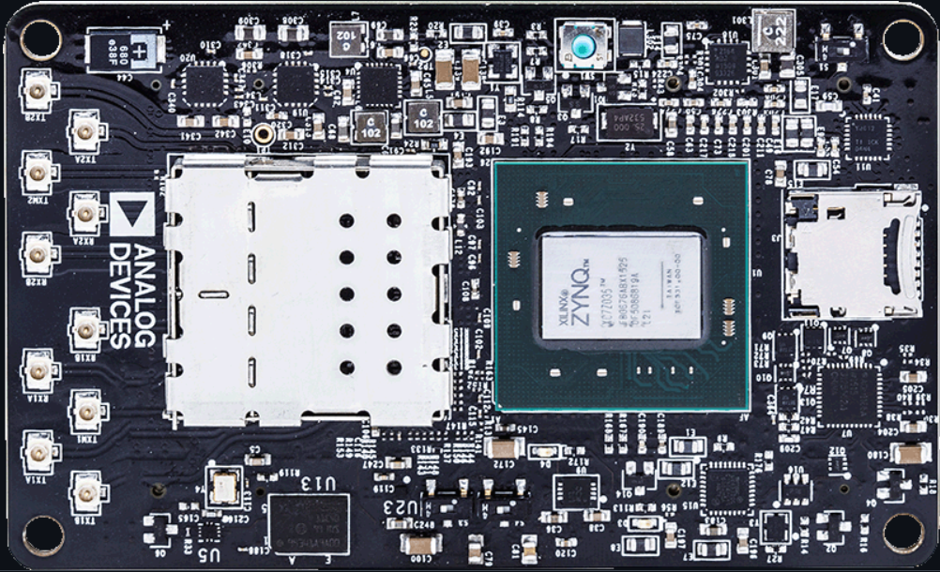
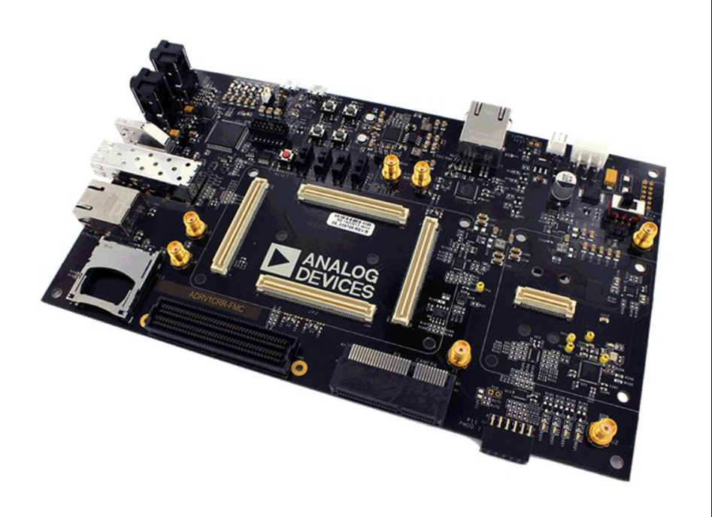
Work 5 : IP Blocks-ADRV-9361
Objective:
Successfully configure and operate and Analog Devices SOM (System-on-Module) on an FMC carrier board without external assistance.
Problem:
The SOM required custom setup to function properly on the FMC board. The provided tools required manual integration of IP blocks, downloading and configuring support files from GitHub, and properly linking XML files. Without this, the board could not communicate or function as expected.
Method Used:
Downloaded and installed necessary IP cores and configuration files from GitHub.
Manually integrated and configured IP blocks in the design environment.
Attached and referenced XML configuration files for proper hardware mapping.
Verified and connected all interfaces between the SOM and FMC carrier board. Working Principle:
Configured the FPGA fabric and peripheral connections by mapping IP blocks to the correct hardware resources.
Ensured the SOM communicated throughout the FMC interface by aligning configuration files and design parameters.
Outcome at NRSC:
Successfully brought up the SOM on the FMC carrier board without external guidance.
Demonstarted full functionality of the board and confirmed correct operation of all configured interfaces.

Slide 9
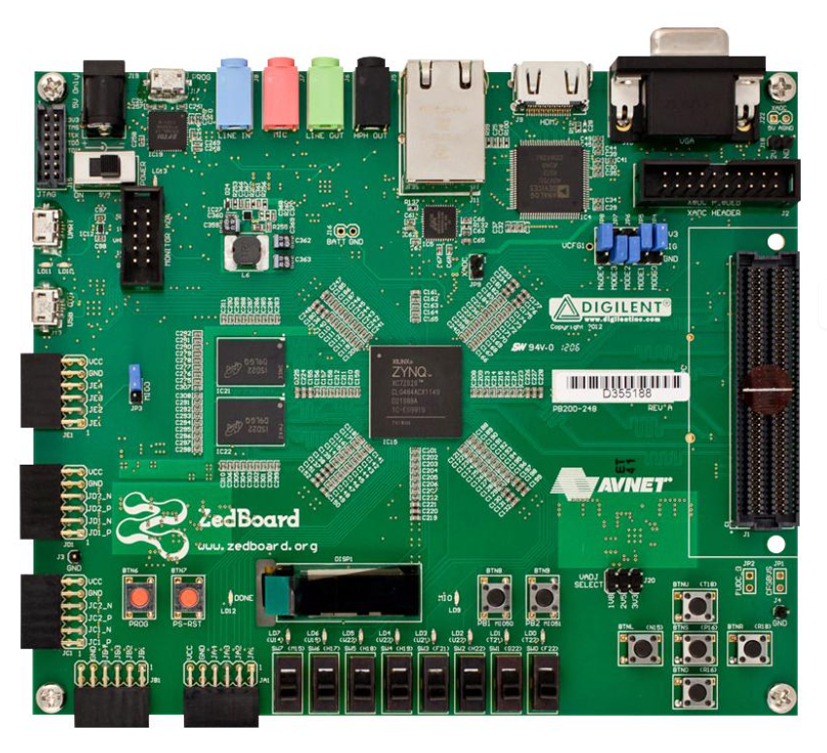
Work 6 : ADC – DAC Loopback on ZCU 208 board
Objective:
Perform ADC-DAC loopback testing on a Xilinx ZCU208 RFSoc board to validate high-speed data conversion and signal processing functionality. Problem:
The ZCU208 requires coordinated configuration of multiple tools to generate, capture, and analyse signals. Achieving a successful loopback demanded proper setup of the ADC and DAC signal paths, firmware, and analysis environments.
Methods Used:
TICS Pro: Configured and controlled the analog front-end (e.g., clocking, PLLs, and JESD204B links for ADC/DAC devices).
Vivado Design Suite: Implemented and synthesized FPGA logic, created the block design for ADC-DAC data routing, and generated the bitstream.
Vitis IDE: Developed and deployed software applications on the RFSoC’s processing system to manage data flow and verify loopback operation.
Spectrum Analyzer: Monitored the output signal to validate signal integrity, frequency content, and loopback performance.
Working Principle: Generated a digital signal through the DAC, looped it back into ADC, and routed the digitized data through the Zynq RFSoC.

Slide 10
Key Learnings & Future Scope
Key Learnings
Future Scope
Real-Time Signal Processing: Hands-on implementation and testing using real-time data across FPGA/RFSoC platforms.
Phase & Symbol Synchronization: Applied piecewise-parabolic interpolation, Zero-Crossing, and Gardner TEDs for symbol synchronization; resolved phase ambiguity using differential and unique-word methods on Zynq-7000.
RF Front-End Configuration: Independently set up ADRV9361-Z7035 SDR and ZCU208 RFSoC boards by manually integrating IP blocks, configuring JESD204B links, and validating ADC-DAC loopback.
Toolchain Expertise:
TICS Pro: Clock configuration and JESD link setup.
Vivado: Hardware design, synthesis, and bitstream generation.
Vitis IDE: Software application deployment and debugging on RFSoCs.
Spectrum Analyzer: Evaluated spectral integrity and loopback performance.
Debugging & Problem-Solving: Learned systematic debugging, timing analysis, and issue resolution without external guidance.
Implementing Viterbi and Reed-Solomon decoders to improve bit error rate performance.
Extend work to multi-channel, higher-bandwidth, and multi-standard RF systems
Automate configuration, testing, and data analysis using Python/Vitis Scripting for faster prototyping.
Explore on-board machine learning accelerators for intelligent signal classification or anomaly detection.
Contribute to system-level satellite communication projects or remote sensing payload development leveraging these skills.

Slide 11
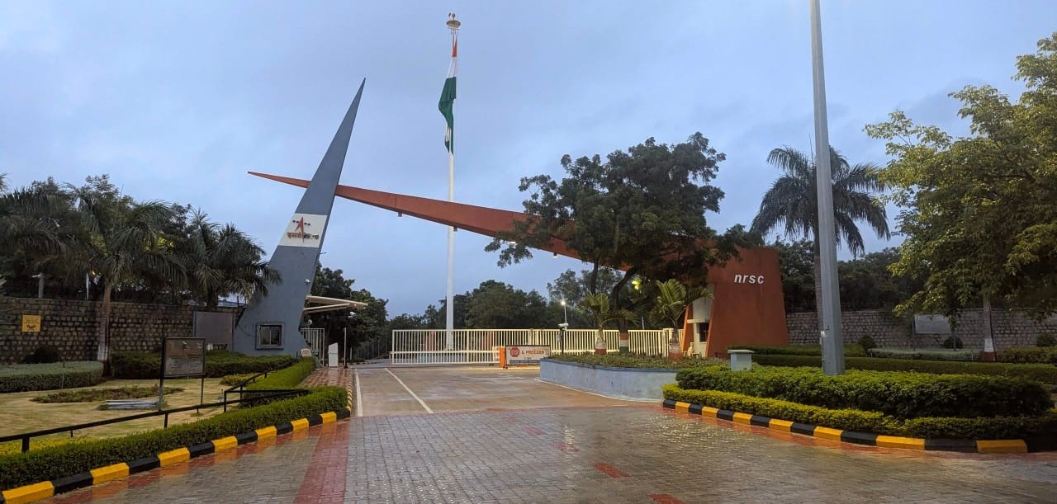
Thank you

